Slide 1
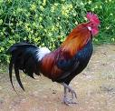


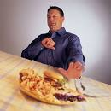

Slide 2
Gastro oesophageal reflux disease (GORD)
Prof Arjuna De Silva MBBS,MD,MSc(Oxon) FRCP,(Lond)FCCP,AGAF,FNASSL
Consultant Physician
Colombo North Teaching Hospital

Slide 3
Case History
A 53-year-old man, who is otherwise healthy
has a 20-year history of occasional heartburn, worsening heartburn for the past 12 months,
daily symptoms that disturb his sleep.
No dysphagia, gastrointestinal bleeding, or weight loss and in fact has recently gained 20 lb (9 kg).

Slide 4
Definition
The Montreal Classification defines GERD as "a condition that develops when the reflux of stomach contents causes troublesome symptoms and/or complications" .
The cardinal symptoms associated with GERD are heartburn and regurgitation.
However, complications from GERD can arise even in patients who lack these typical symptoms.

Slide 5
More definitions
Heart burn
Burning sensation behind the breast bone
Regurgitation
The perception of the reflux flow of the
gastric contents into the mouth or hypo
larynx

Slide 6
And more -Definitions
For population studies
Mild symptoms - >2 days a week
Moderate symptoms >1 day a week
Considered troublesome
In clinical practice – the patient will decide

Slide 7
Epidemiology
GORD is a normal phenomenon and occurs <4% of the time in normal people
It becomes abnormal if it is frequent or the patient becomes symptomatic
It is one of the most common diseases in the western world, with a prevalence of almost 20/100000 in the >40 yr olds in the UK

Slide 8
Classification GORD
Oesophageal
Syndromes
Extraoesophageal
Syndromes
Symptomatic
Syndromes
Syndromes with
oesophageal injury
Proposed associations
Established
associations
Reflux oesophagitis
Reflux stricture
Barretts
Adenocarcinoma
Pharyngitis
Sinusitis
IPF
Recurrent
ottitis media
Typical reflux
Reflux chest pain syndrome
Re cough syndrome
Re laryngitis
Syndrome
Re Asthma
Syndrome
Re dental erosion
syndrome

Slide 9
Pathogenesis
Anti reflux mechanisms
LOS
Diaphragm
Intra abdominal oesophagus
Mucosal rosette

Slide 10
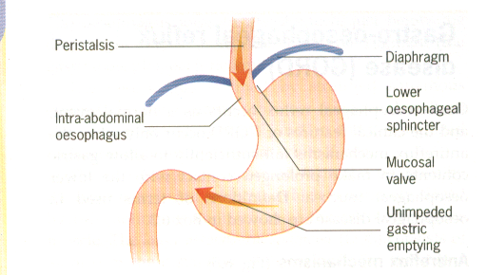
Anti reflux mechanism

Slide 11
Pathogenesis
Factors that increase gastro-esophageal
Reflux
(Hurry, worry and curry!)
Pregancy , obesity
Foods
Smoking, alcohol
Drugs Ca channel, Nitrates
Hiatus hernia

Slide 12
Clinical features
Heart burn (dyspepsia)
Regurgitation
Respiratory symptoms
Alarm symptoms
Dysphagia
Loss of weight
Odynophagia
Melaena

Slide 13
Diagnosis
HISTORY
Endoscopy
Barium swallow
24 hr pH monitoring
Histology

Slide 14
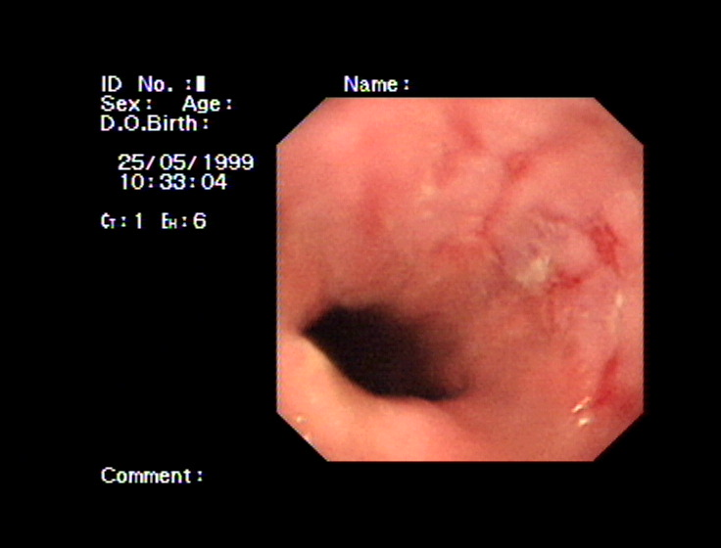
Reflux

Slide 15
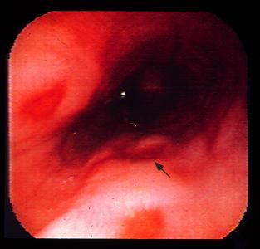
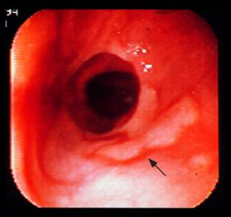
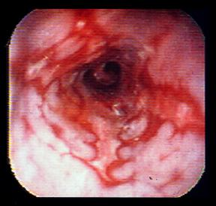
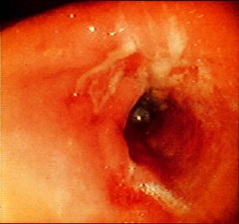
Savary –Millar
I –one or more spots,
non confluent
II- lesions confluent, non circunferntial
III – circumferential
IV Complications

Slide 16
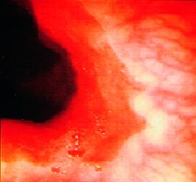
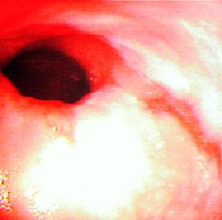
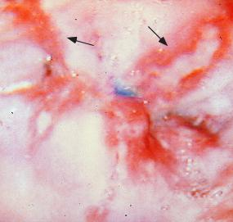
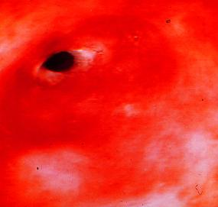
Los Angeles Classification
>1 mucosal breaks each
<5 mm in length
Mucosal breaks >5mm
A
B
One break continuous at top
Break >3/4 of circumference
C
D

Slide 17
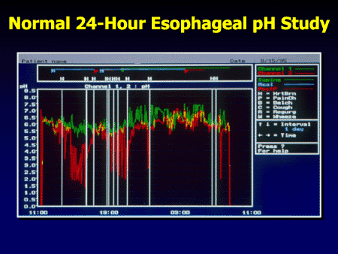

Slide 18
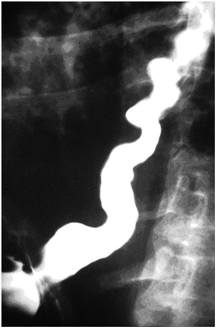
Barium swallow

Slide 19
Management
Life style modifications
Weight reduction
Smoking
Alcohol
Food
Clothing
Sleeping posture

Slide 20
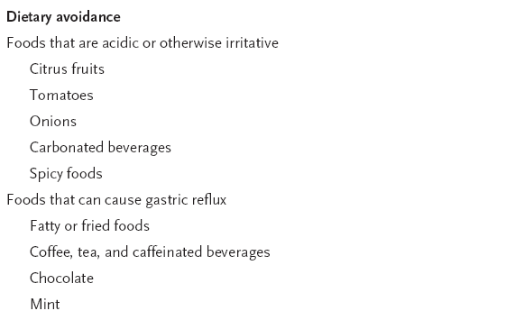
Management

Slide 21
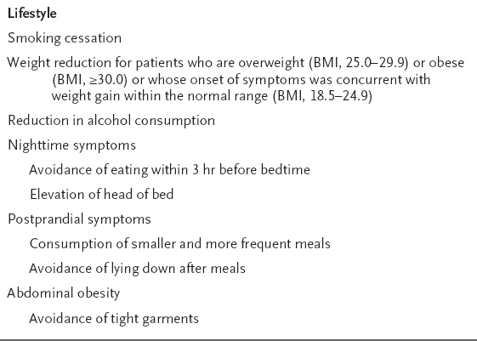
Lifestyles

Slide 22
Drugs
Antacids
PPI
Omeprazole,Rabeprazole,Pantoprazole,Esomeprazole
H2 receptor blockers
Cimetidine, Ranitidine
Prokinetics
Domperidone, Metachlopramide, Cisapride- not routinely advised unless motility problem

Slide 23
PPI
Better than H2 receptor blockers
Rabeprazole fastest action
Esomeprazole better than omeprazole
Long term efficacy > 11 yrs data ok
Pregnancy –avoid but not data to say it is teratognenic

Slide 24
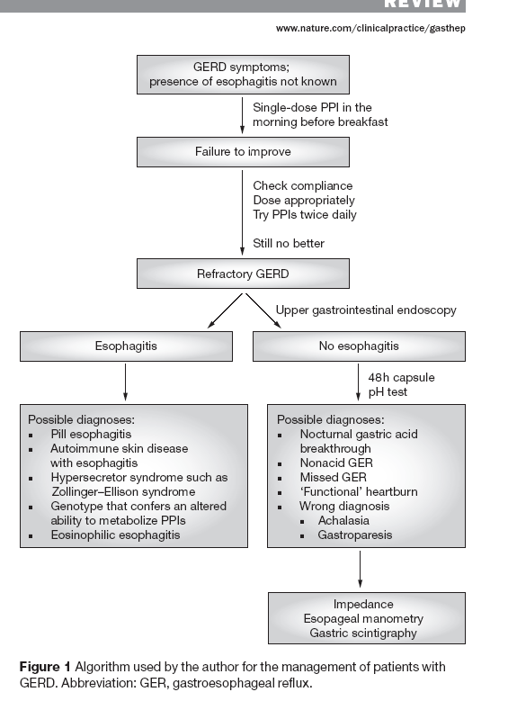

Slide 25
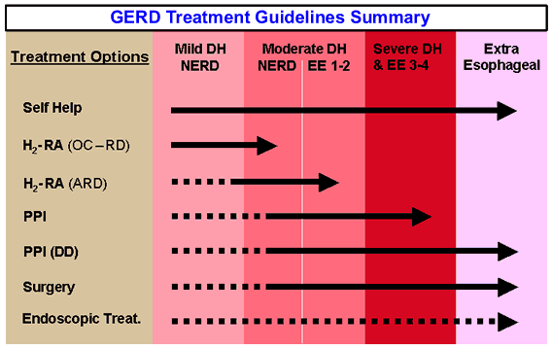

Slide 26
Surgery
Not first option
Nissan fundoplication
Can be done endoscopically as well

Slide 27
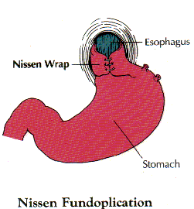
Nissen Fundoplication

Slide 28
Complications
Barrett’s
Carcinoma
Stricture
Aspiration

Slide 29
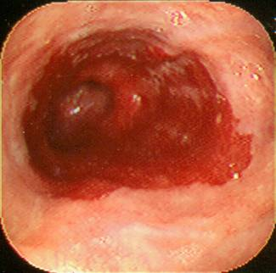
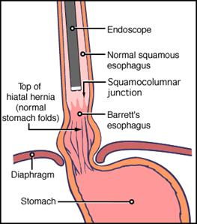
Barrett’s

Slide 30
ESEM(endocopically suspected oesophgeal metaplasia )
Term Barrett’s used only when gastric metaplasia demonstrated on histology
Barretts SIM (Specialized intestinal metaplasia )
Four quadrent biopsy every 1cm to identify dysplasia

Slide 31
Barrett’s
>3 cm from GOJ
Pre malignant
Barrettes , low grade, high grade
High grade – surgery
Low grade - surveillance –controversial
Long term PPI

Slide 32
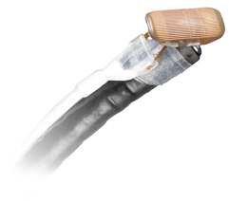
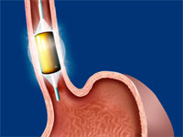
Barrett’s –Treatment
HALO- 360 system

Slide 33
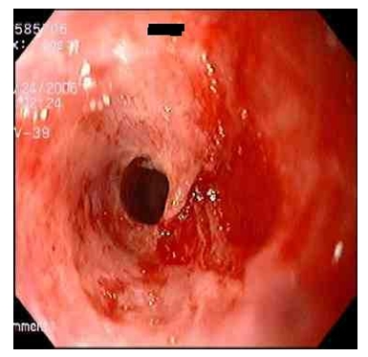
Stricture

Slide 34
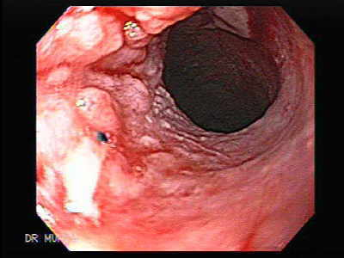
Oesophageal CA

Slide 35
Miscellaneous
NERD (Non erosive reflux disease)
Safety of long term PPI (>10)*
H pylori eradication
Pregnancy
*Klinkenberg-Knol EC - Gastroenterology 2000 Apr;118(4):661-9.

Slide 36
How do we manage our patient?
Exclude cardiac pain
Weight loss, other life style measures
Twice daily PPI
Endoscopy
No complications
Long term PPI
If symptom not relieved /pt not satisfied 24hr pH monitoring –then surgery

Slide 37
Summary
GORD is one of the commonest diseases that will be encountered in GP practice
Clinical diagnosis
Exclude cardiac pain
Endoscopy if diagnosis unclear or alarm symptoms
Life style modifications
Drugs - PPI
Surgery-on an individual basis

Slide 38
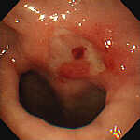
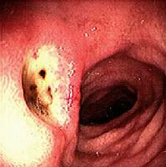
Peptic Ulcer disease
Gastric ulcers
Duodenal ulcers

Slide 39
Aetiology
Acid pepsin V Mucosal barrier
Helicobactor Pylori
NSAIDS

Slide 40
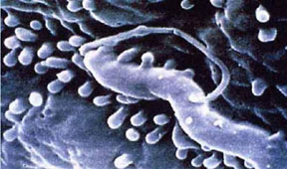
Hpylori
Spiral shaped flagellated gram negative bacteria
Produces urease
Found mainly in the antrum
Increases gastrin production
Implicated in 90% of DUs and most of GU as well
Treat for 2 weeks

Slide 41
Hpylori cont
VacA &Cag + strains are more virulent
Causes atropic gastritis, gastric metaplasia and gastric carcinoma
Also implicated in gastric lymphoma
Diagnosed non invasively, using breath test or by histology and culture

Slide 42
Management
General measures
Stop smoking
Stop NSAIDS
Stop Worrying ?

Slide 43
Treatment
Symptomatic
Antacids- Magnesium trisilicate
- Aluminium hydroxide
- Alginate containing
- Local anaesthetics
Dose 10 ml tid or in tablet form

Slide 44
Diagnosis
History
Examination
ENDOSCOPY- Biopsy all gastric ulcers
H pylori status – Breath test, biopsy

Slide 45
Management
General measures
Stop smoking
Stop NSAIDS
Stop Worrying ?

Slide 46
Treatment
Symptomatic
Antacids- Magnesium trisilicate
- Aluminium hydroxide
- Alginate containing
- Local anaesthetics
Dose 10 ml tid or in tablet form

Slide 47
Treatment
Proton pump inhibitors (PPI)
Act by inhibiting H/K ATPase
Complete acid suppression
Drug of choice
Omeprazole 20mg , Lansoprazole30mg, Rabeprazole 20mg, Pantoprazole and Esomeprazole 40mg

Slide 48
Treatment
Other agents
Misoprostol
H2 receptor blockers
Sucralfate

Slide 49
Maintenance
DU – 4 to 6 weeks of PPI adequate
GU - 4 to 6 weeks of PPI then re endoscopy
GU that are , Large (> 2cm) that bleed may need long term > 1 Year PPI

Slide 50
Summary
All patients will need endoscopy if you suspect PU
Biopsy all GU
General measures ie Stop smoking, NSAIDs
H pylori eradication
PPI- 4- 6 weeks
Long term maintenance treatment in some patients

